Slide 1

16-bit RO Physical Unclonable Function ---EEL4720 Final Project
Shida yang
Beichen Su

Slide 2
Table of Content
Introduction to the application
Design and Implementation
Testing and demonstration
Test Results
Problem Encountered
Potential Solution and New Results
Conclusion

Slide 3
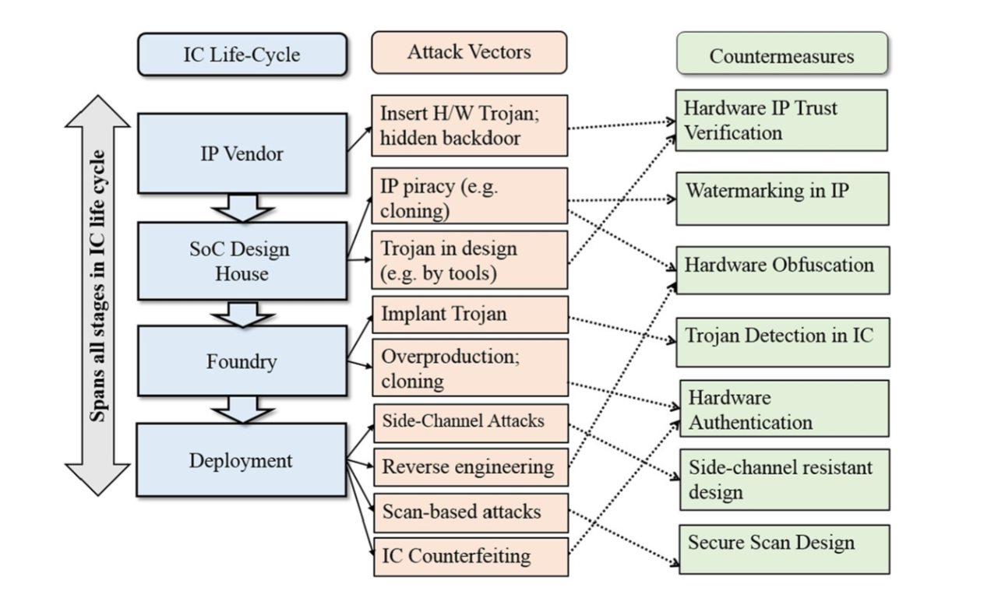
Introduction
Nowadays, people rely more and more on their digital devices, which stored so many important privacy information like radio-frequency identification (RFID). Hardware security is becoming increasingly important.
Our application is mainly focused on hardware authentication

Slide 4
Introduction
In traditional methods, secret keys are stored digitally in a nonvolatile memory which is always vulnerable based on hardware implementation and key storage.
For extremely resource contained platform such as radio-frequency identification (RFID), even simple cryptographic operations can be too costly.
Software-only protection is not enough. Non-volatile memory technologies are vulnerable to invasive attack as secrets always exist in digital form.
adversaries can physically extract secret keys from EEPROM while processor is off
Due to the differences between each devices (length, width, oxide thickness) in circuit and system (Process Variation), each IC has unique properties.

Slide 5
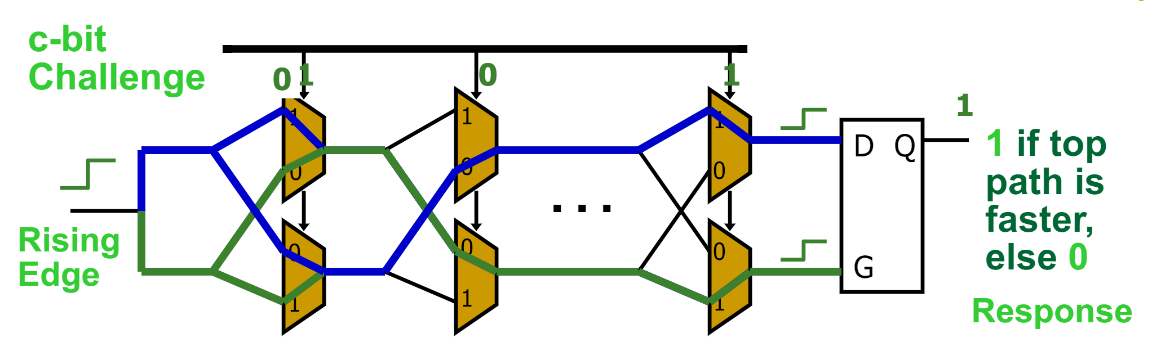
Introduction
Physical Unclonable Function (PUF) is a function that is:
Based on a physical system
Easy to evaluate (using the physical system)
Outputs looks like random function
Unpredictable even for an attacker with physical access
Path delays in an IC are statistically distributed due to random manufacturing variations

Slide 6
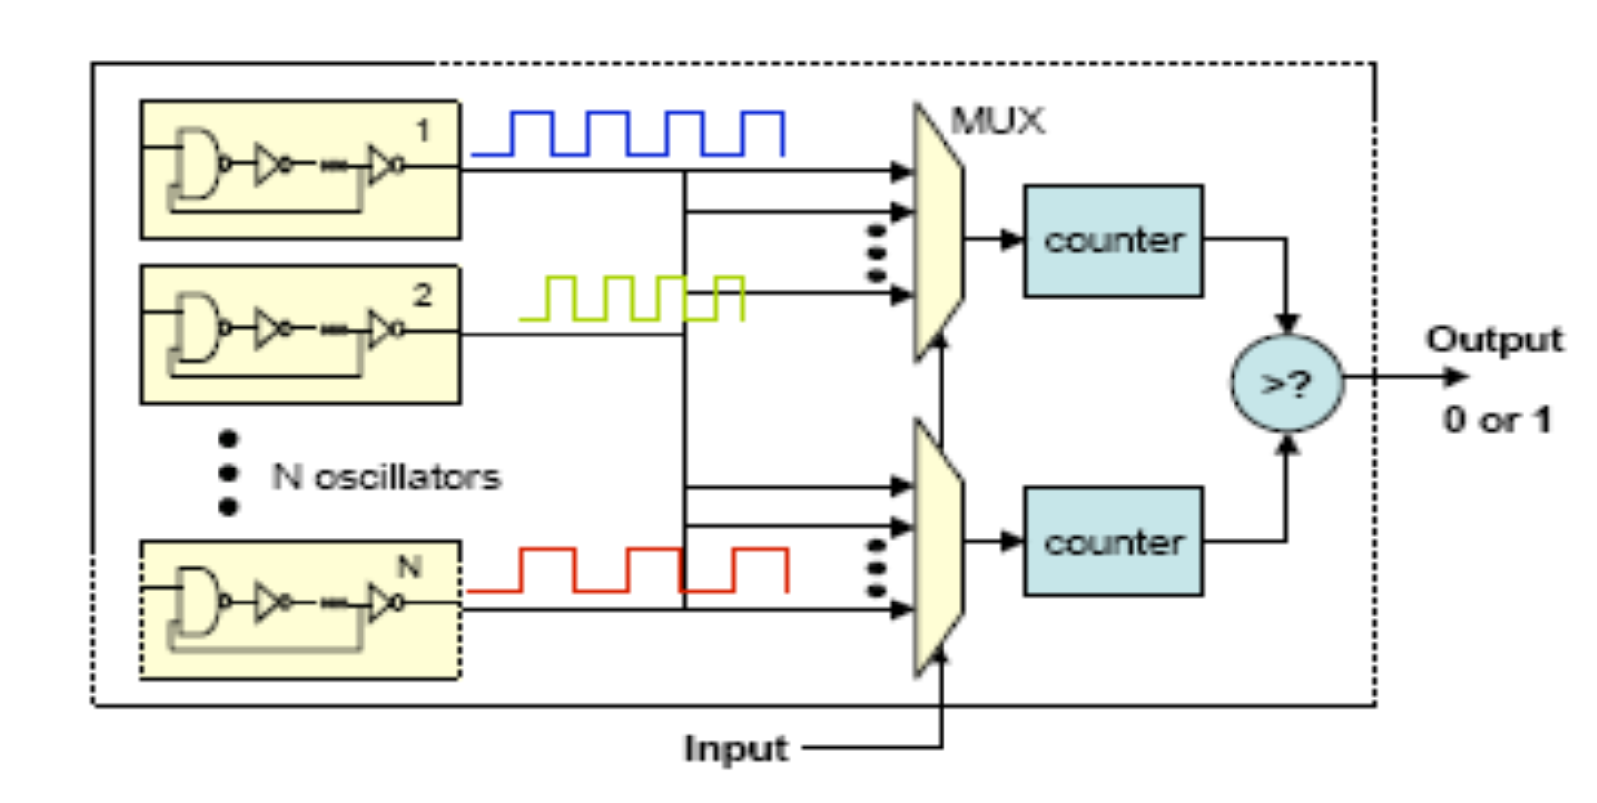
Introduction
Ring-Oscillator (RO) PUF replies on delay loops and counters instead of MUX and arbiters because it will be more stable on FPGA.
Our design is implementing a 16-bit RO PUF. Input (Challenge) is 16 bit and the output is 1 bit. We store 32 different 16-bit challenges, generated by a random generator function, in RAM and pass through all challenges one by one to form a 32-bit response sequences.

Slide 7
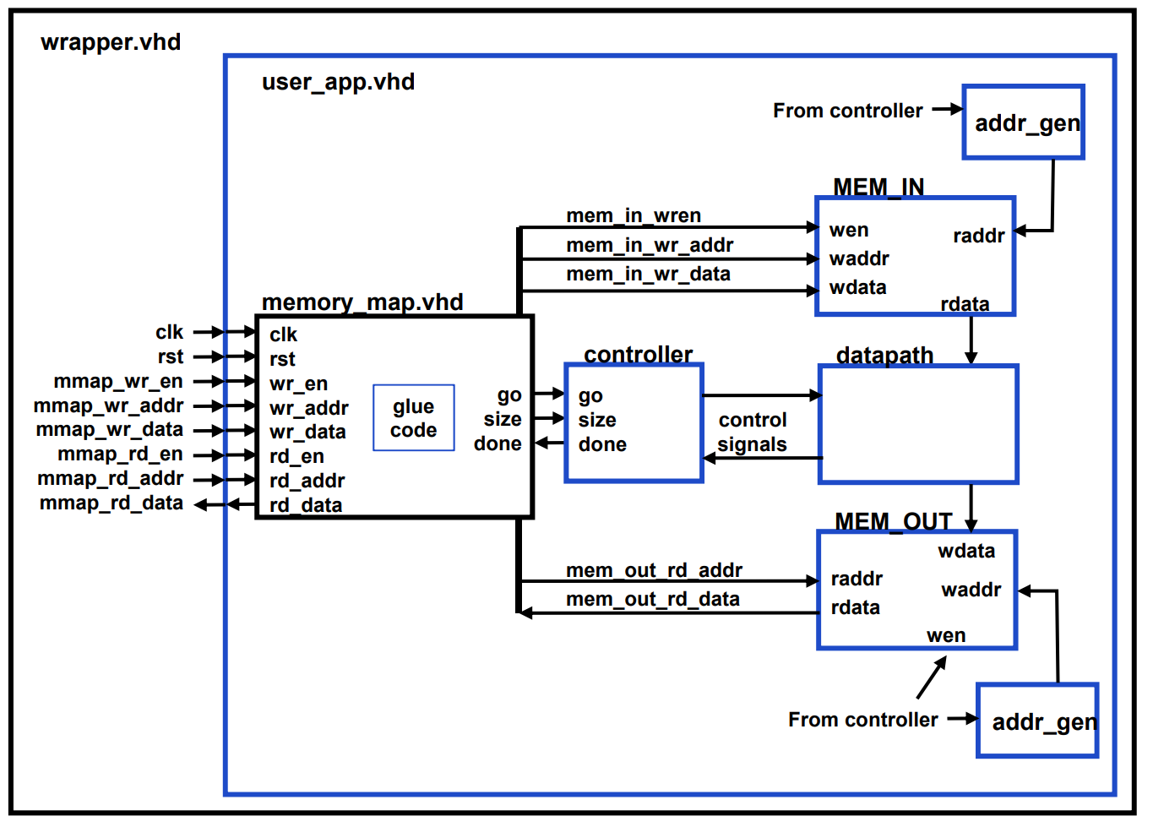
Design and Implementation

Slide 8
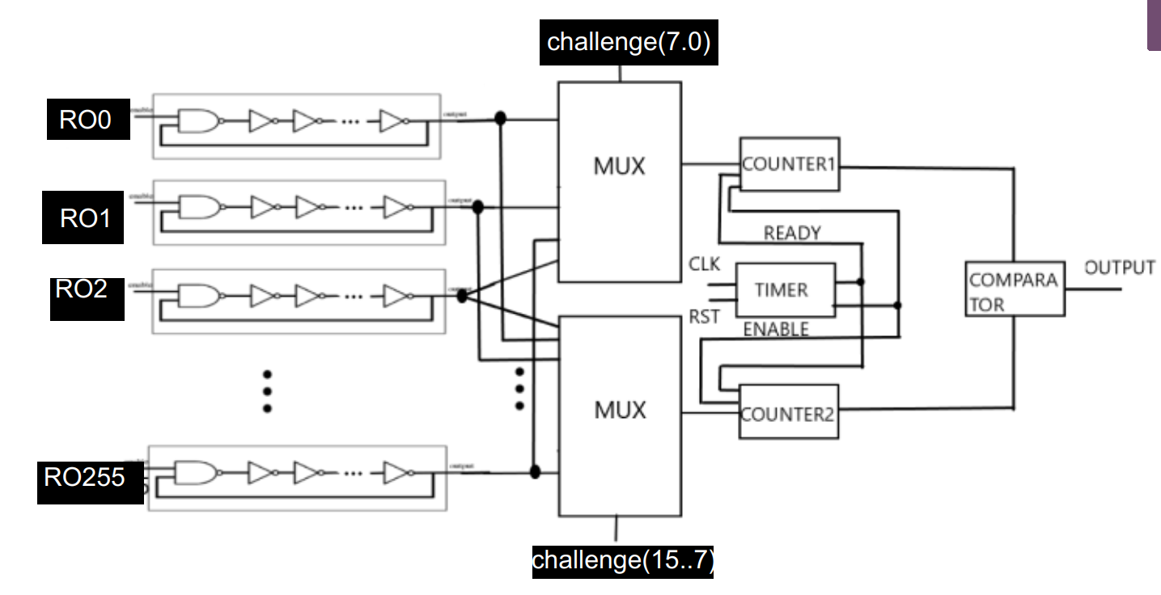
Design and Implementation

Slide 9
Test and Demo (Method and Goal)
We will use intra-Hamming Distance and inter-Hamming Distance to test our design.
What is Hamming Distance?
Given two numbers, calculate the fraction of bits that are different
For example, use two 8-bit number
0b11001010
0b10001011
2 different bits, so HD=2/8=0.25

Slide 10
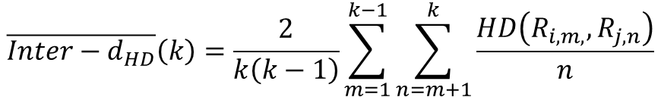
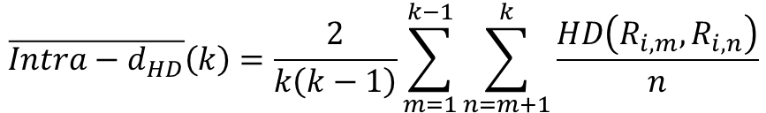

Test and Demo (Method and Goal)
Intra-HD
Give same set of input to the same chip multiple times
Compare the HD between the outputs
Tells how reliable the design is
Ideally close to 0 because a reliable design should have the same output for the same input
Inter-HD
Give same set of input to different chips
Compare the HD between the outputs across chips
Tells how unique each chip is when implementing the same design
Ideally close to 0.5 because each bit has two possible outcomes, so half of the bits should be different on average
$$\overline{Intra−d_{HD}}\left(k\right)=\frac{2}{k\left(k−1\right)}\sum_{m=1}^{k−1}{\sum_{n=m+1}^{k}{\frac{HD\left(R_{i, m}, R_{i, n}\right)}{n}}}$$
$$\overline{Inter−d_{HD}}\left(k\right)=\frac{2}{k\left(k−1\right)}\sum_{m=1}^{k−1}{\sum_{n=m+1}^{k}{\frac{HD\left(R_{i, m,}, R_{j, n}\right)}{n}}}$$
$$R_{x, y}=y^{th} response of board x$$

Slide 11
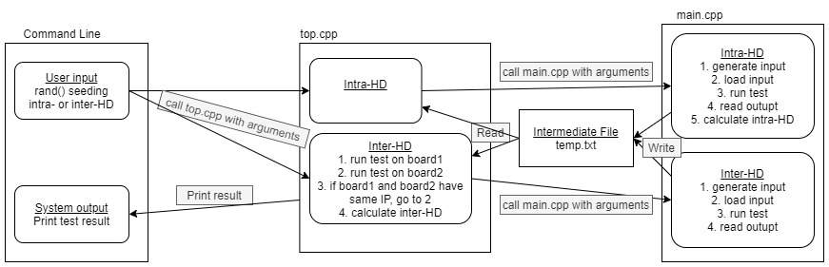
Test and Demo (Data and Control Flow)

Slide 12
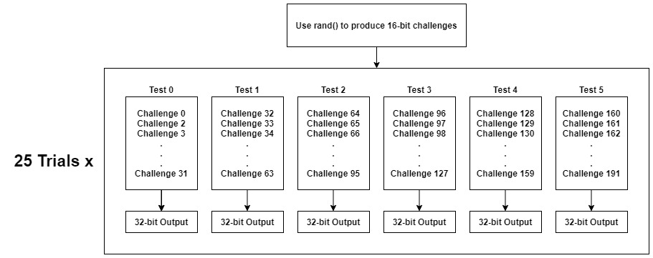
Test and Demo (main.cpp – Input/Output)

Slide 13
Test and Demo (main.cpp – Intra-HD)
25 outputs in the same test from 25 trials
Output 0 ~ Output 24
Pairing output (every possible combination)
Output 0 – Output 1, Output 0 – Output 2, Output 0 – Output 3, Output 0 – Output 4, …Output 0 – Output 23, Output 0 – Output 24
Output 1 – Output 2, Output 1 – Output 3, Output 1 – Output 4, …Output 1 – Output 23, Output 1 – Output 24
Output 2 – Output 3, Output 2 – Output 4, … Output 2 – Output 23, Output 2 – Output 24
……
Output 23 – Output 24
For each pair, calculate intra-HD
Find number of different bits (n), divide by total number of bits (32)
n/32
Average the intra-HDs

Slide 14
Test and Demo (top.cpp – Inter-HD)
Keep doing test until get results from two different boards
25 outputs from board 1, 25 outputs from board 2
Pair them up just like in the previous slide
First element in the pair is from board 1, second element is from board 2
For each pair, calculate inter-HD
Find number of different bits (n), divide by total number of bits (32)
n/32
Same algorithm for calculating Hamming Distance, just the pairs are from different boards
Average the inter-HDs

Slide 15
Test and Demo (Command Line)
./top.o RAND_SEED INTRA_OR_INTER
RAND_SEED: make sure the same set of input is given to the board
INTRA_OR_INTER: 0=inter-HD, 1=intra-HD
Printed Result
6 tests, each test is the average of 25 trials

Slide 16
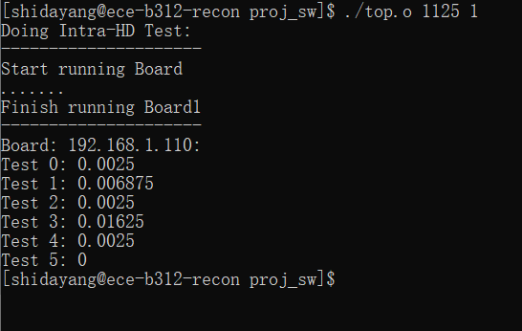
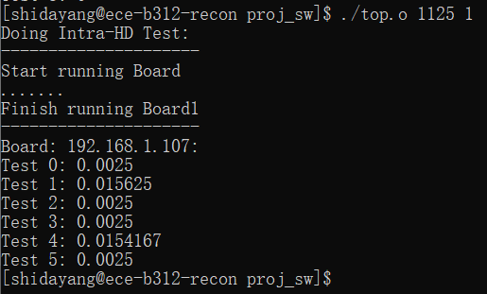
Result (Intra-HD)

Slide 17
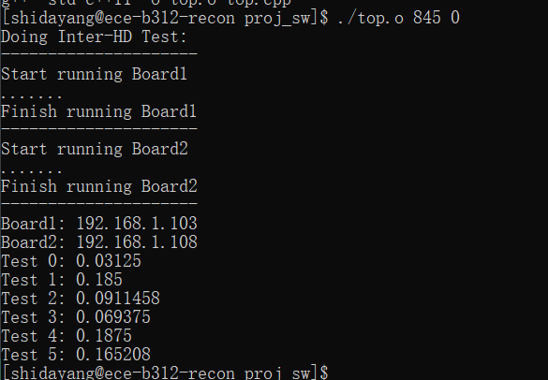
Result (Inter-HD)
The average inter-HDs we measured from our boards are far from ideal
Should be around 0.5 ideally
Our data ranges from 0.03 to 0.18
The implemented design favors certain ROs over others (explained in the next slide)

Slide 18
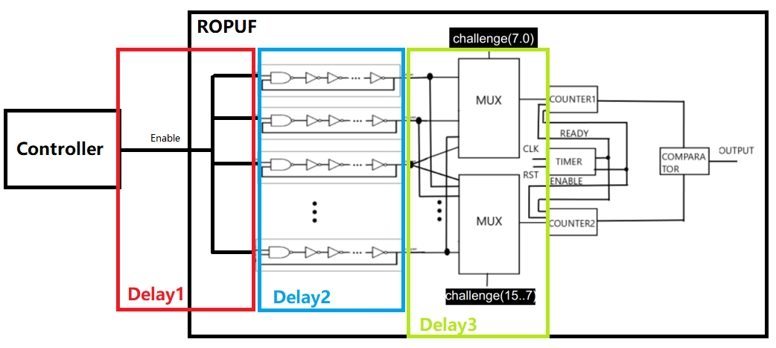
Problem Encountered
The output bit ultimately depends on the difference between the propagation delays along different paths
The choice of path is determined by the challenge

Slide 19
Problem Encountered
Total delay = Delay1 + Delay2 + Delay3 + PV
Delay1: enable signal from the controller to the ROs
Delay2: signal traveling through the internal routing of the ROs
Delay3: RO output to counters
PV: process variation
Successful ROPUF design should be symmetric enough to keep Delay1, Delay2, and Delay3 the same so that the output only depends on PV

Slide 20
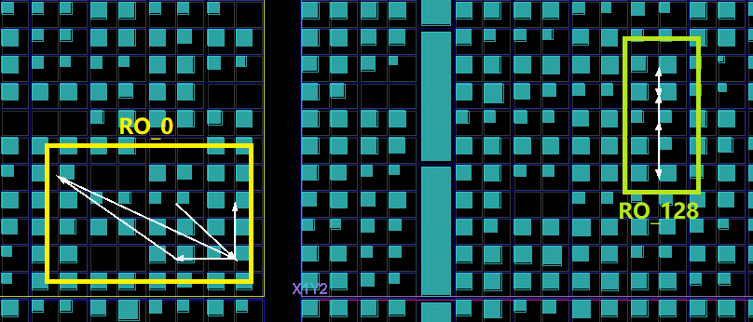
Problem Encountered
The internal routing of each Ring-Oscillator is different when using automatic place and route
If a challenge is 0b10000000 00000000
Mux1 selects RO_128, Mux0 selects RO_0
Internal routing lengths are different, making Delay2 different

Slide 21
Problem Encountered
Board1
Delay Type | RO_0 Path | RO_128 Path
Delay1 | 2 | 5
Delay2 | 25 | 15
Delay3 | 5 | 1
PV | 4 | 3
Total Delay | 36 | 24
Internal Routing (Delay2) is a major source of delay because we have many NOT gates in each RO
Ideal cases, when putting design on different boards, only PV should change
The difference between Delay2’s along different paths makes the PV insignificant
No matter which board you run the design on, the output will favor RO_128 in this case
Board2
Delay Type | RO_0 Path | RO_128 Path
Delay1 | 2 | 5
Delay2 | 25 | 15
Delay3 | 5 | 1
PV | 1 | 4
Total Delay | 33 | 25

Slide 22
Solution
Use Tcl commands to manually place and route the Ros
Use unplace_cell to clear an area
Use place_cell to place the LUTs of each RO identically
Link to the command file

Slide 23
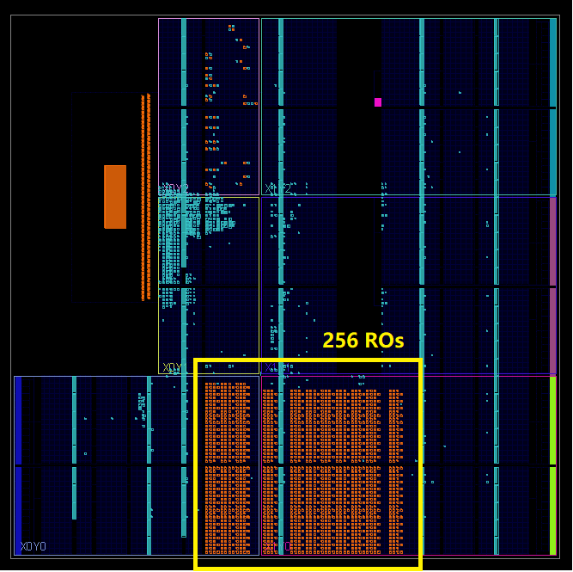
Solution (Placement)

Slide 24
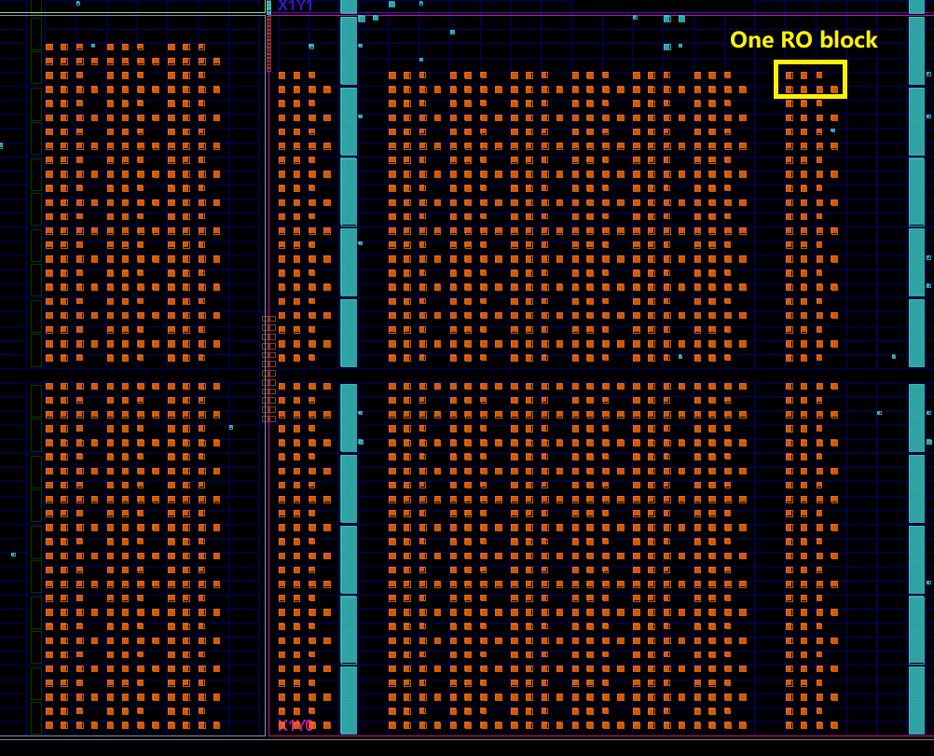
Solution (Placement)
Need to skip some columns because we want to place blocks at locations where the available routing resources are identical

Slide 25
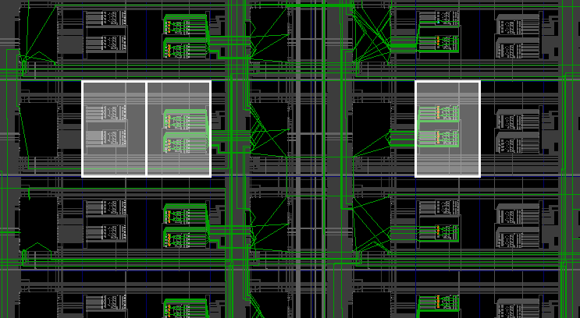
Solution (Routing)
A, B, and C are three adjacent tiles locate in different columns
Each RO needs two tiles
Choose AB vs. BC results in different available internal routing resources
Since ROs in other columns have available routing resources like BC does, we have to skip column A and use BC
A B C

Slide 26
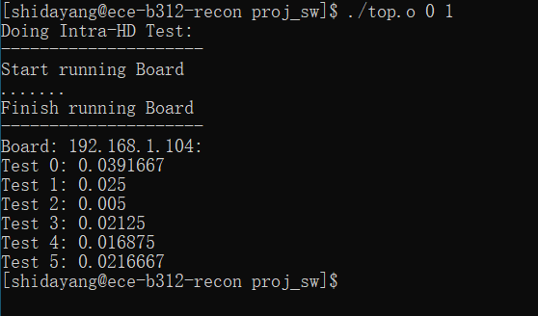
New Result (Intra-HD)
After making these changes, the intra-HDs are still good

Slide 27
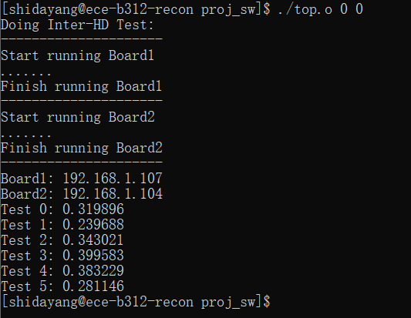
New Result (Inter-HD)
Before change After change

Slide 28
Possible Improvements and Limitations
PV has a greater change to dominate the output
But Delay1 and Delay3 can sometimes dominate, making inter-HD less than 0.5
Possible solution:
Change placement so that the routing between the controller and each RO are the same (decrease difference between Delay1’s)
Change placement so that the routing between the RO and the counter are the same (decrease difference between Delay3’s)
Choose FPGAs with greater process variation (increase difference between PV)
Board1
Delay Type | RO_0 Path | RO_128 Path
Delay1 | 2 | 5
Delay2 | 15 | 15
Delay3 | 5 | 1
PV | 4 | 3
Total Delay | 36 | 24
Board2
Delay Type | RO_0 Path | RO_128 Path
Delay1 | 2 | 5
Delay2 | 15 | 15
Delay3 | 5 | 1
PV | 1 | 4
Total Delay | 23 | 25

Slide 29
Possible Improvements and Limitations
Limitations (why we did not make those improvement):
To change placement, we need to consider the routing resources as well. If the ROs are not placed column by column, it is hard to keep track of the internal routing of 256 ROs manually
We are limited to the kind of boards we have
Board1
Delay Type | RO_0 Path | RO_128 Path
Delay1 | 2 | 5
Delay2 | 15 | 15
Delay3 | 5 | 1
PV | 4 | 3
Total Delay | 36 | 24
Board2
Delay Type | RO_0 Path | RO_128 Path
Delay1 | 2 | 5
Delay2 | 15 | 15
Delay3 | 5 | 1
PV | 1 | 4
Total Delay | 23 | 25

Slide 30
Conclusion
We build a 16-bit Ring Oscillator Physical Unclonable Function with great complexity in both hardware structure and software algorithm, which can be used in hardware security protection in the real world.
Currently it is highly reliable and relatively special for each devices, which can be shown from our test output and data analysis. We are satisfied about our progress and result.

Slide 31
Reference
[1] Tehranipoor and C. Wang (Eds.), Introduction to Hardware Security and Trust, Springer, 2011
[2] R. Pappu, B. Recht, J. Taylor, and N. Gershenfeld. 2002. Physical one-way functions. Science 297(2002), 2026–2030.
[3] B. Gassend, D. Clarke, M. van Dijk, and S. Devadas. 2002. Silicon physical random functions. In CCS. 148–160.
[4] M. Majzoobi, M. Rostami, F. Koushanfar, D.S. Wallach, and S. Devadas. 2012. Slender PUF Protocol: A Lightweight, Robust, and Secure Authentication by Substring Matching. In IEEE Symposium on Security and Privacy Workshops (SPW). 33 – 44.

